Slide 1
Theme Style Guide
Accent Slot | Hext Color | Usage
Accent 1 | #XXXXXX | Slide Titles, major headings
Accent 2 | #XXXXXX | Secondary Headers, comparison titles
Accent 3 | #XXXXXX | Highlight callouts, icon files
Accent 4 | #XXXXXX | Links, interactive elements
Accent 5 | #XXXXXX | Alerts, warnings, caution text
Accent 6 | #XXXXXX | Captions, footers, diver lines
Corina
Corina
Corina
Corina
Corina
Corina

Slide 2
Style Guide: Color Palette (Base Colors)
Role | Hex Color | Usage
Text/Background – Dark 1 | #333333 | Primary text
Text/Background – Light 1 | #FFFFFF | Slide background
Text/Background – Dark 2 | #003366 | High-contrast text (e.g., captions, data overlays)
Text/Background – Light 2 | #F4F6F7 | Soft fill areas, minimal containers
Hyperlink | #3399FF | Linked text in body placements
Followed Hyperlink | #DD3377 | Previously click links

Slide 3
Style Guide: Color Palette (Accent Colors)
Accent Slot | Hex Color | Usage
Accent 1 | #003366 | Main slide titles, major headers
Accent 2 | #008080 | Primary box fills, minor headings, comparison titles
Accent 3 | #DD3377 | Secondary content box fills, icon fills, highlight overlays
Accent 4 | #FF6600 | Links, callouts, interaction indicators
Accent 5 | #3399FF | Alerts, caution text, emphasis on risks
Accent 6 | #666666 | Footer text, captions, divider lines, body text for inactive elements

Slide 4
Theme Style Guide: Typography
Slide Title | Font Family | Style | Size (pts) | Line Spacing
Slide Title | Kamerik205 8 | Regular | 44 | —
Section Header | Inter | Semibold or Bold | 36 / 20-22 | —
Body Level 1 | Inter | Regular | 28 | Multiple 1.15
Body Level 2 | Inter | Regular | 24 | Multiple 1.15
Body Level 3 | Inter | Regular | 20 | Multiple 1.15
Body Level 4 | Inter | Regular | 18 | Multiple 0.90
Body Level 5 | Inter | Regular | 18 | Multiple 0.90
Caption/Label Text | Inter | Medium | 16 | —
Footer Text | Inter | Italic | 14 | —

Slide 5
Style Guide: Layouts
Layout Name | Use Case | Key Features
Title Slide | Opening slide with workshop or session title | Completely blank; expects a title slide image to be used
Title and Content | General-purpose slides with bullets or visuals | Default layout with full-width title and body placeholder
Section Header | Slide breaks for new topics or modules | High-emphasis title, optional supporting visual or icon
Two Content | Binary workflows or parallel breakdowns | Equal width placeholders
Comparison | A vs B pattern contrasts | Titles above each content box, divider line
Title Only | Modular storytelling grid (1-4 content boxes per row) | Full-width title, guide-based grid (12 columns x 9 rows) box fills in Accent 3/2
Blank | Custom slides, visual experiments, isolated visuals | No placeholders, use guides or freestyle design
Content with Caption | Small narrative zone + major visual zone | Left text zone, right content zone
Picture with Caption | Image-driven slides with descriptive labeling | Full-width image placeholder

Slide 6
Style Guide: Content Box Styles
Primary
Primary
Primary
Secondary
Secondary
Secondary
Primary
Primary
Secondary
Secondary
Primary
Primary
Secondary
Primary
Secondary
Primary

Slide 7
Style Guide: Content Box Fill Styling
Box Type | Fill | Overlay | Text Color | Notes
Primary | Accent 3 @ 20% | None | Dark 1 | For active context boxes
Secondary | Accent 2 @ 20% | None | Dark 1 | Supporting or alternate boxes
Inactive | Accent 3 or 2 | Shadow overlay @ 20% opacity | Accent 6 | Creates depth, dims focus interntionally

Slide 8
Advanced Processing Techniques
Notes:
Welcome to the Advanced Processing Techniques module. In this section, we will explore sophisticated patterns that elevate the reliability and efficiency of your messaging solutions. These advanced techniques are crucial for handling complex messaging scenarios and ensuring that your systems can scale and perform under various conditions.
BY the end of this module, you will be equipped with the knowledge to implement advanced processing techniques, making your messaging systems more resilient and efficient. So, let’s enhance your messaging capabilities to tackle even the most challenging scenarios!

Slide 9
Advanced Processing Techniques
Pattern 1: Idempotent Receiver

Slide 10
What is the Idempotent Receiver Pattern
Ensures message is processed exactly once
Prevent duplicate processing of messages
Notes:
Definition
The Idempotent Receiver pattern ensures that a message is processed exactly once, even if the message is received multiple times. This is achieved by designing the receiver to recognize and discard duplicate messages.
Purpose
The purpose of the Idempotent Receiver pattern is to prevent duplicate processing of messages, ensuring reliable and accurate message handling.

Slide 11
Key Components & Flow
Unique Message Identifiers
State Storage
Idempotent Processing Logic
Notes:
Unique Message Identifiers: Use unique identifiers for each message to track which messages have been processed.
State Storage: Maintain a state storage system (e.g., database, in-memory cache) to store and check the processing status of messages.
Idempotent Processing Logic: Implement logic in the receiver to check for duplicate messages and discard them if they have already been processed.

Slide 12


Key Components & Flow
1
Unique Message Identifiers
2
2
4
4
3
1
State Storage
2
2
2
3
3
4
2
3
4
1
4
3
Idempotent Processing Logic
4
Notes:
Unique Message Identifiers: Use unique identifiers for each message to track which messages have been processed.
State Storage: Maintain a state storage system (e.g., database, in-memory cache) to store and check the processing status of messages.
Idempotent Processing Logic: Implement logic in the receiver to check for duplicate messages and discard them if they have already been processed.

Slide 13
Benefits
Data Integrity
Reliability
Efficiency
Notes:
Data Integrity: Ensures that each message is processed exactly once, maintaining accurate and consistent data.
Reliability: Prevents duplicate processing, reducing the risk of errors and inconsistencies in the system.
Efficiency: Minimizes unnecessary processing by discarding duplicate messages, optimizing resource usage.

Slide 14
Drawbacks
Complexity
State Management
Notes:
Complexity: Implementing idempotent processing logic adds complexity to the system design.
State Management: Requires maintaining state information to identify and discard duplicate messages.

Slide 15
Use Cases
Payment Processing
Order Management
Inventory Updates
Notes:
Payment Processing
Ensuring that payment transactions are processed only once, even if the payment request is received multiple times due to network issues.
Order Management
Preventing duplicate order creation when multiple requests are received for the same order.
Inventory Updates
Ensuring inventory counts are updated correctly without duplication when the same update message is received more than once.

Slide 16
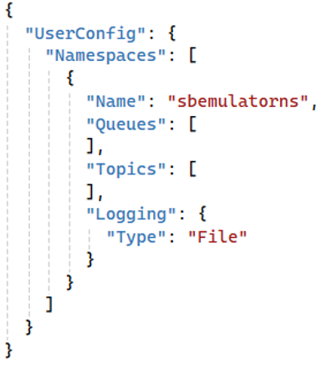
Documentation
Create Namespace

Slide 17
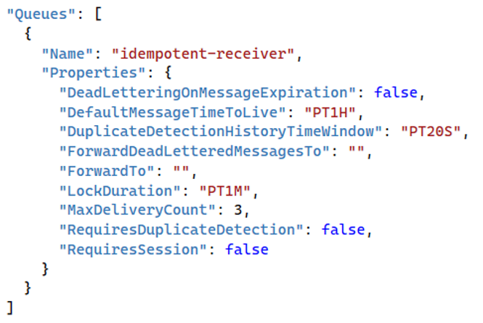
Documentation
Create Namespace
Create the Queue

Slide 18
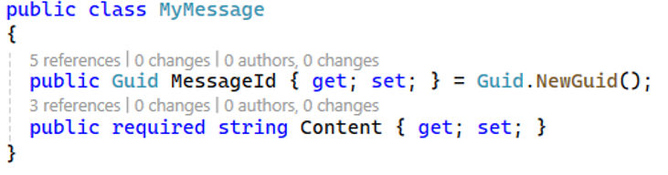
Documentation
Create Namespace
Create the Queue
Create the State Entity

Slide 19
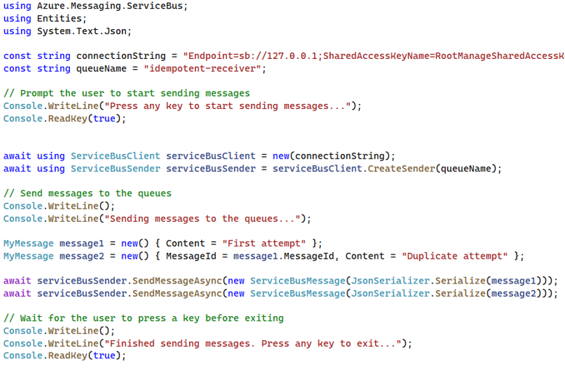
Documentation
Create Namespace
Create the Queue
Create the State Entity
Create the Producer

Slide 20
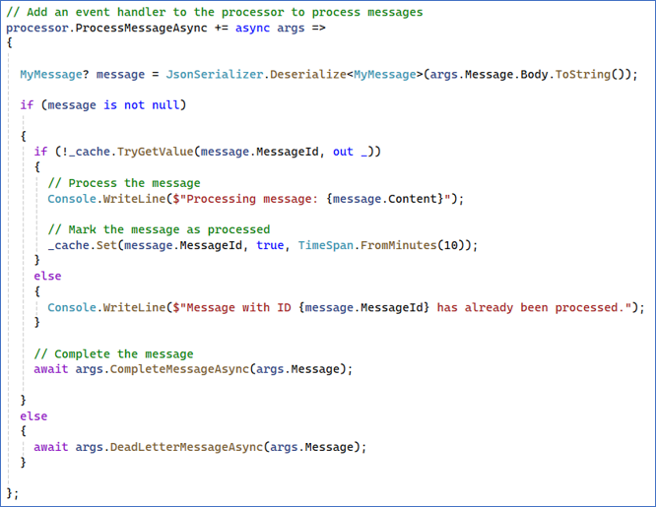
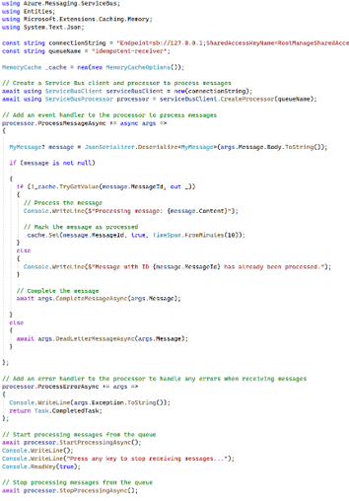
Documentation
Create Namespace
Create the Queue
Create the State Entity
Create the Producer
Create the Receiver

Slide 21
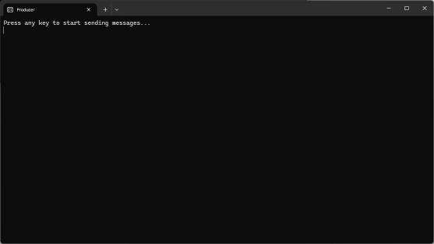
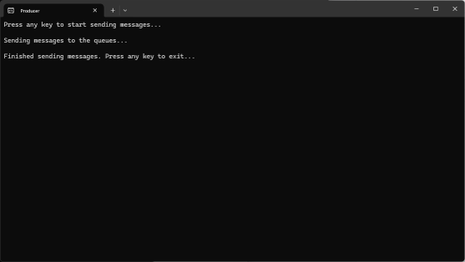
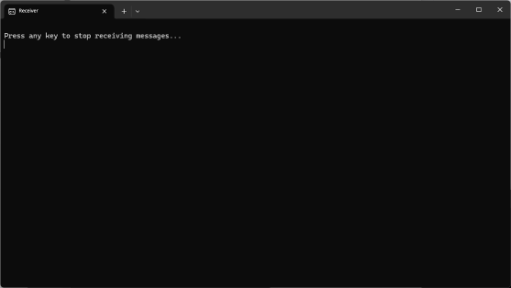
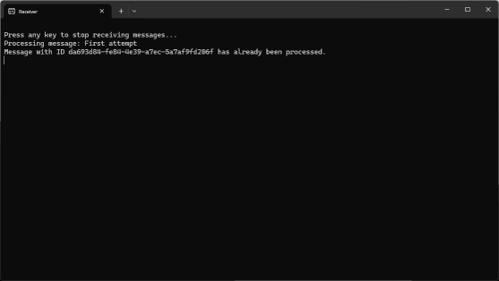
Documentation
Producer
Create Namespace
Create the Queue
Create the State Entity
Create the Producer
Create the Receiver
Consumer
Run the Demo

Slide 22
Key Points to Remember
Use Unique Identifiers
Maintain Processing State
Implement Idempotent Logic
Monitor and Audit
Notes:
Use Unique Identifiers: Assign unique identifiers to each message to facilitate tracking and identification.
Maintain Processing State: Use state storage to keep track of processed messages and prevent duplicate processing.
Implement Idempotent Logic: Design the receiver to recognize and discard duplicate messages based on their unique identifiers.
Monitor and Audit: Continuously monitor the system and audit message processing to ensure the idempotent receiver is functioning correctly.

Slide 23
Advanced Processing Techniques
Pattern 2: Messaging Scheduling

Slide 24
What is the Idempotent Receiver Pattern
Delaying the processing of a message.
Enable system to handle tasks at appropriate times.
Notes:
Definition
Message scheduling involves delaying the processing of a message until a specified date or condition is met. This pattern allows message to be processed at a further date or after certain conditions are satisfied.
Purpose
The purpose of message scheduling is to provide controlled and timed message processing, enabling the system to handle tasks at appropriate times or under specific conditions.

Slide 25
Key Components & Flow
Scheduler
Queue
Time-Based Triggers
Notes:
Scheduler: A component responsible for scheduling messages to be processed at a specific time or after certain conditions are met.
Queue: A message queue that holds scheduled messages until their scheduled processing time arrives.
Time-Based Triggers: Mechanisms that trigger the processing of scheduled messages at the appropriate time.

Slide 26
Key Components & Flow
Scheduler
1 min
1 min
1 min
1 min
1 min
Queue
1 min
Time-Based Triggers
Notes:
Scheduler: A component responsible for scheduling messages to be processed at a specific time or after certain conditions are met.
Queue: A message queue that holds scheduled messages until their scheduled processing time arrives.
Time-Based Triggers: Mechanisms that trigger the processing of scheduled messages at the appropriate time.

Slide 27
Benefits
Controlled Processing
Resource Optimization
Improved Reliability
Notes:
Controlled Processing: Allows for precise control over when messages are processed, improving system flexibility and efficiently.
Resource Optimization: Enables deferred processing during off-peak hours, reducing the load on the system during busy period.
Improved Reliability: Provides a mechanism for retrying failed messages without immediate reproducing, allowing time for transient issues to be resolved.

Slide 28
Drawbacks
Complexity
Potential Delays
Notes:
Complexity: implementing message scheduling adds complexity in the system design.
Potential Delays: Introduces delays in message processing, which may not be suitable for time-sensitive tasks.

Slide 29
Use Cases
Delayed Notifications
Batch Processing
Retry Logic
Notes:
Delayed Notifications
Sending notifications or alerts at a scheduled time, such as reminders for appointments or follow-up messages.
Batch Processing
Deferring the processing of messages until off-peak hours to optimize resource usage and system performance.
Retry Logic
Scheduling retries for failed messages to be processed at a later time, allowing transient issues to resolve.

Slide 30
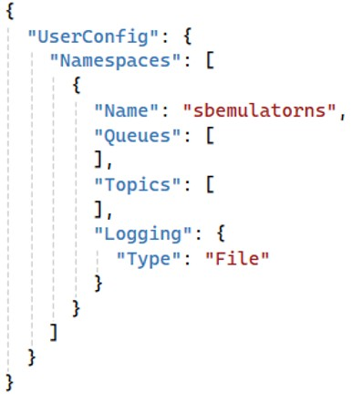
Documentation
Create Namespace

Slide 31
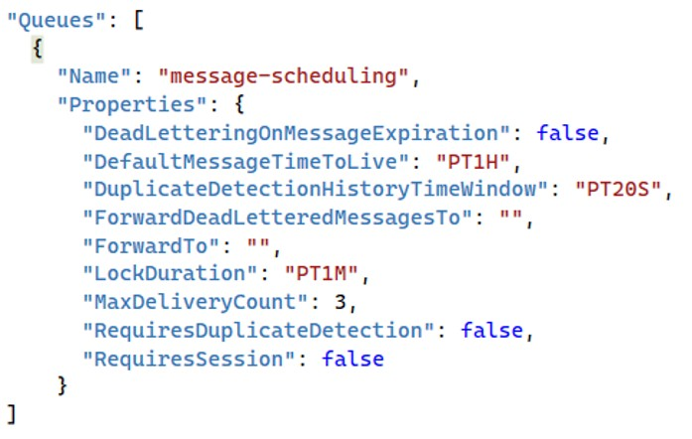
Documentation
Create Namespace
Create the Queue

Slide 32
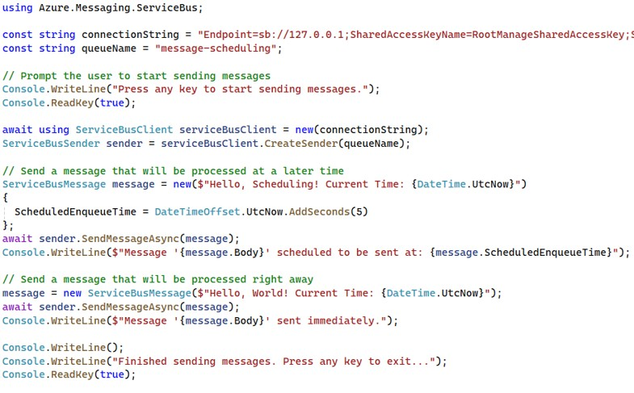
Documentation
Create Namespace
Create the Queue
Create the Producer

Slide 33
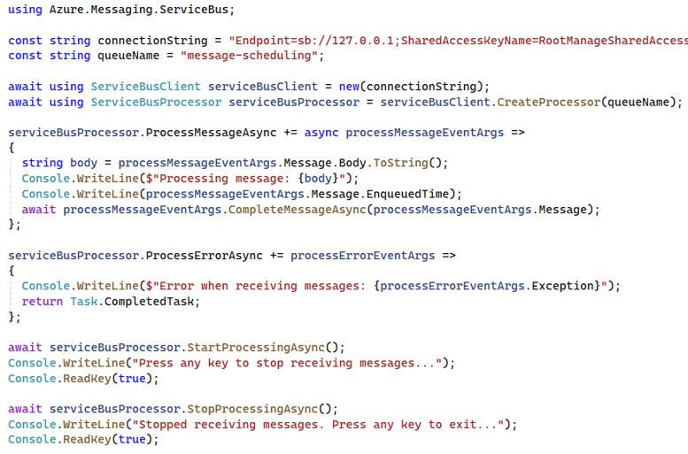
Documentation
Create Namespace
Create the Queue
Create the Producer
Create the Consumer

Slide 34
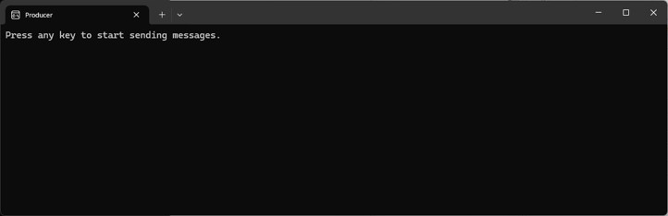
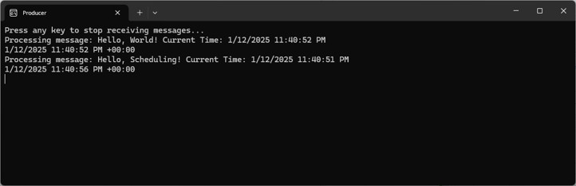
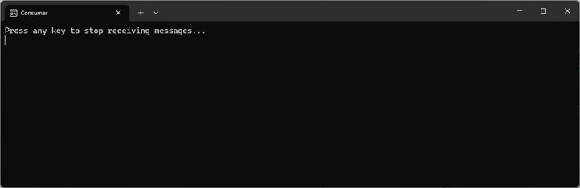
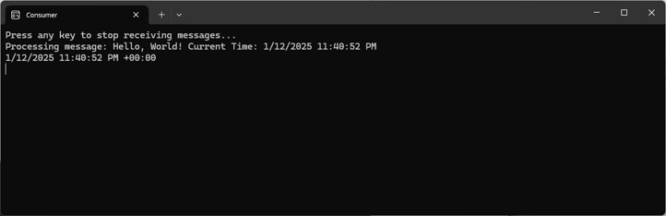
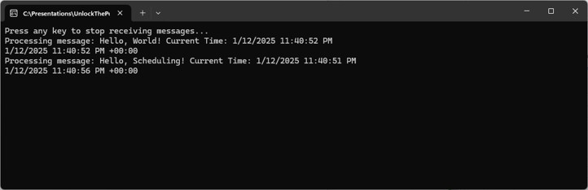
Documentation
Producer
Create Namespace
Create the Queue
Create the Producer
Create the Consumer
Consumer
Run the Demo

Slide 35
Key Points to Remember
Define Scheduling Criteria
Implement Scheduling Logic
Monitor and Manage
Handle Failures
Notes:
Define Scheduling Criteria: Clearly define the criteria for scheduling messages, such as specific times or conditions.
Implement Scheduling Logic: Use scheduling logic to enqueue messages with a specified delay or condition.
Monitor and Manage: Continuously monitor scheduled messages and manage their processing to ensure timely and reliable execution.
Handle Failures: Implement mechanisms to handle failures and retries for scheduled messages, ensuring they are processed correctly.

Slide 36
Advanced Processing Techniques
Pattern 3: Claim Checks

Slide 37
What is the Idempotent Receiver Pattern
Storing large payloads in external storage and passing a reference
Reduce the size of messages in the queue
Notes:
Definition
The Claim Check pattern involves storing large message payloads in an external storage system and passing a reference (claim check) through the message queue. The receiving system uses this reference to retrieve the payload form the storage system when needed.
Purpose
The purpose of the Claim Check pattern is to reduce the size of messages in the queue, improving performance and scalability by offloading large payloads to an external storage system.

Slide 38
Key Components & Flow
External Storage System
Claim Check
Message Queue
Payload Retrieval Logic
Notes:
External Storage System: A reliable storage system (e.g., blob storage, database) to store large message payloads.
Claim Check: A unique reference or identifier that is included in the message in order to retrieve the payload from the storage system.
Message Queue: The messaging system that passes lightweight messages containing the claim check.
Payload Retrieval Logic: Logic to retrieve the payload from the external storage system using the claim check when needed.

Slide 39


Key Components & Flow
External Storage System
Claim Check
Message Queue
Payload Retrieval Logic
Notes:
External Storage System: A reliable storage system (e.g., blob storage, database) to store large message payloads.
Claim Check: A unique reference or identifier that is included in the message in order to retrieve the payload from the storage system.
Message Queue: The messaging system that passes lightweight messages containing the claim check.
Payload Retrieval Logic: Logic to retrieve the payload from the external storage system using the claim check when needed.

Slide 40
Benefits
Improved Performance
Scalability
Resource Efficiency
Notes:
Improved Performance: Reduces the size of messages in the queue, allowing for faster transmissions and processing.
Scalability: Offloads large payloads to an external storage system, enabling the message queue to handle a higher volume of messages.
Resource Efficiency: Optimizes the use of queue resources by keeping messages lightweight and manageable.

Slide 41
Drawbacks
Complexity
Latency
Dependencies
Notes:
Increased Complexity: Introduces additional complexity by requiring coordination between the messaging system and external storage.
Potential Latency: Retrieving large payloads from external storage may introduce latency, especially if the storage system is slower.
Dependency Management: Increases dependency on the external storage system, which must be reliable and performant.

Slide 42
Use Cases
Large File Transfers
Complex Data Structures
Resource Optimization
Notes:
Large File Transfers
When transferring large files or multimedia content, storing the files externally and passing references ensures efficient message processing.
Complex Data Structures
For messages containing complex or large data structures, using a claim check prevents overloading the message queue.
Resource Optimization
Optimizing the use of message queue resources by reducing the payload size and ensuring faster message transmission.

Slide 43
Documentation
Create the Namespace

Slide 44
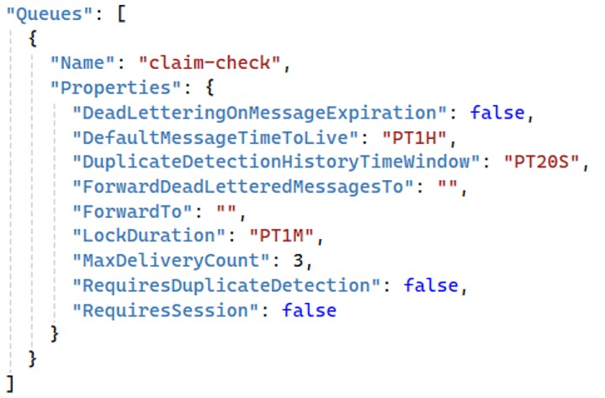
Documentation
Create the Namespace
Create the Queue

Slide 45
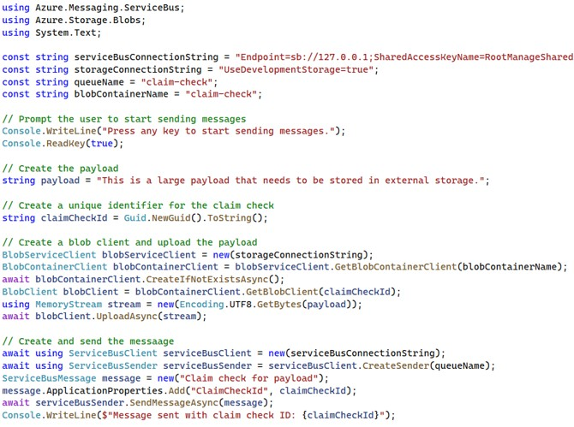
Documentation
Create the Namespace
Create the Queue
Create the Queue

Slide 46
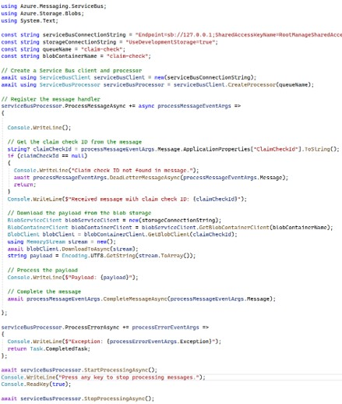
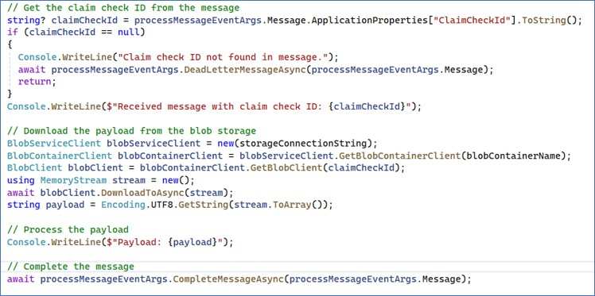
Documentation
Create the Namespace
Create the Queue
Create the Queue
Create the Consumer

Slide 47
Documentation
Create the Namespace
Create the Queue
Create the Queue
Create the Consumer
Run the Demo

Slide 48
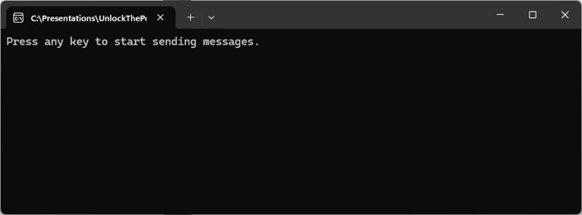
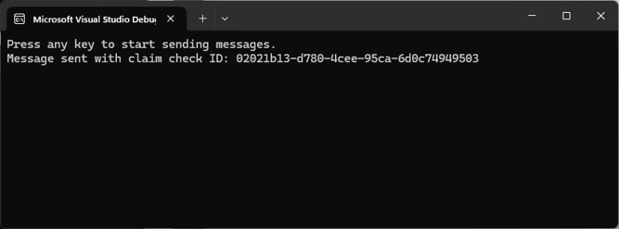
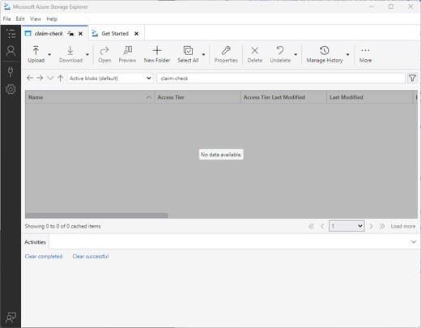
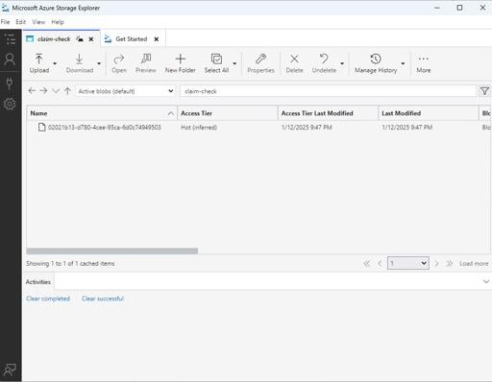
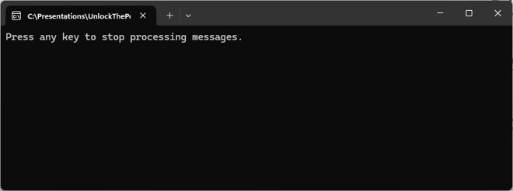
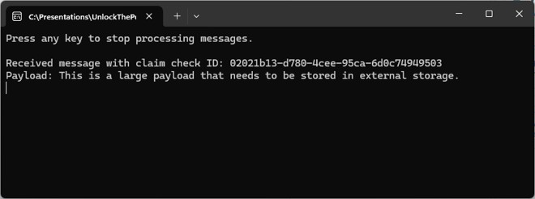
Producer
Consumer

Slide 49
Key Points to Remember
Storage Large Payloads Externally
Include Claim Checks
Ensure Storage Reliability
Coordinate Components
Notes:
Store Large Payloads Externally: Use an external storage system to store large message payloads and keep the message queue lightweight.
Include Claim Checks: Pass references or claim checks through the message queue to retrieve the payload when needed.
Ensure Storage Reliability: Use a reliable and performant external storage system to store and retrieve large payloads efficiently.
Coordinate Components: Ensure proper coordination between the messaging system and the external storage to maintain consistency and reliability.

Slide 50
Advanced Processing Techniques
Wrap-Up

Slide 51
Key Takeaways
Idempotent Receivers
Message Scheduling
Claim Checks
Notes:
As we conclude the Advanced Processing Techniques module, let’s summarize the key patterns and insights we have covered, and preview what is coming up next.
Key Takeaways:
Idempotent Receiver: Ensuring that messages are processed safely multiple times without unintended side effects.
Message Scheduling: Techniques for delaying messaging processing until a specified time.
Claim Check: Efficiently offloading large messages form the queue to handle them more effectively.
These patterns have provided you with advanced tools to improve the reliability and efficiency of your messaging solutions.

Slide 52
Preview of What’s Next in the Workshop
Messaging Essentials
Core Messaging Patterns
Routing & Processing
Advanced Processing Techniques
Resilience & Reliability
Streaming & Integrations
Data Considerations
Hands-On Exercises

Slide 53
Preview of What’s Next in the Workshop
Resilience & Reliability
Circuit Breaker
Saga
Sequence Convoy
Notes:
In the next module, we will look into essential patterns that ensure you messaging systems are resilient and reliable. Here is a glimpse of what is to come:
Circuit Breaker: Introducing fault tolerance and resilience in your messaging solutions.
Saga: Managing long-running transactions with distributed systems.
Sequential Convoy: Handling related messages in a specific order.
These upcoming patterns will further enhance your ability to design robust and scalable messaging systems. Stay tuned as we continue our journey into building resilient and reliable messaging solutions!

